Slide 1
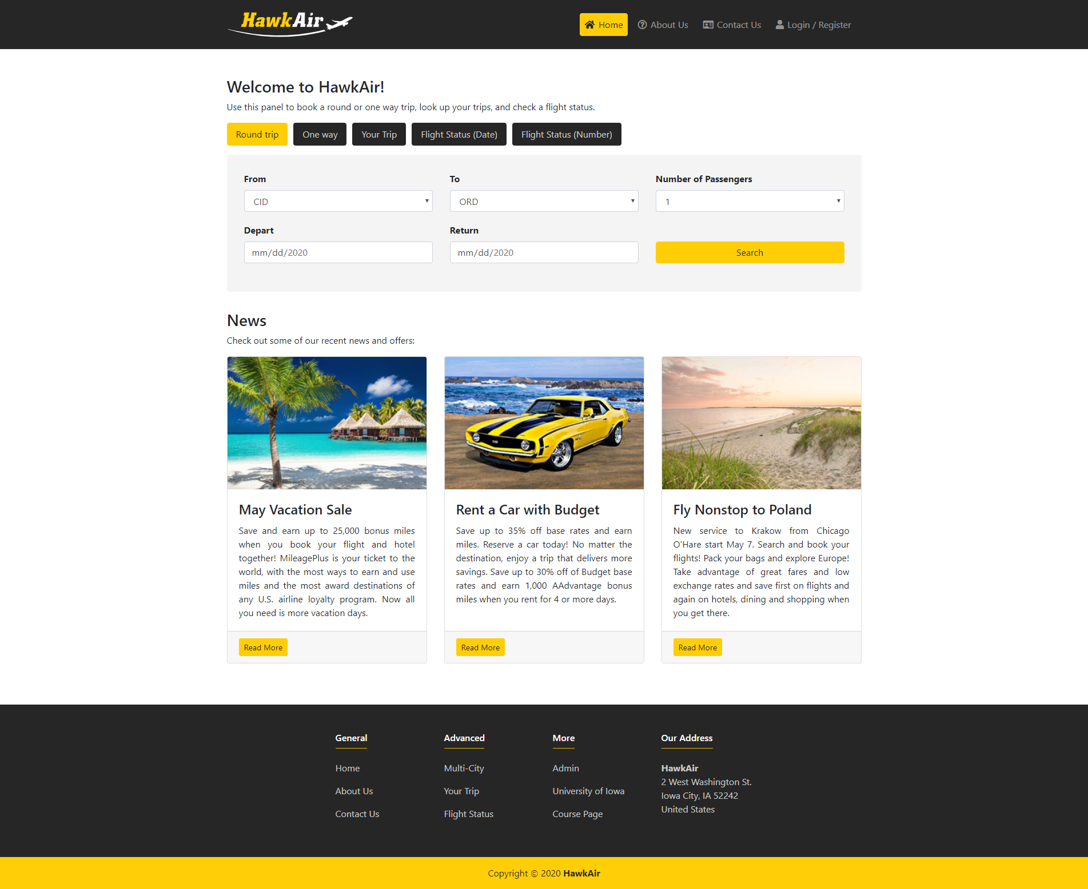
HawkAir
Airline Database System
Jacob Seedorff Piotr Smietana Sriram Srinivasan
CS:4400 Team #5 May 4, 2020

Slide 2
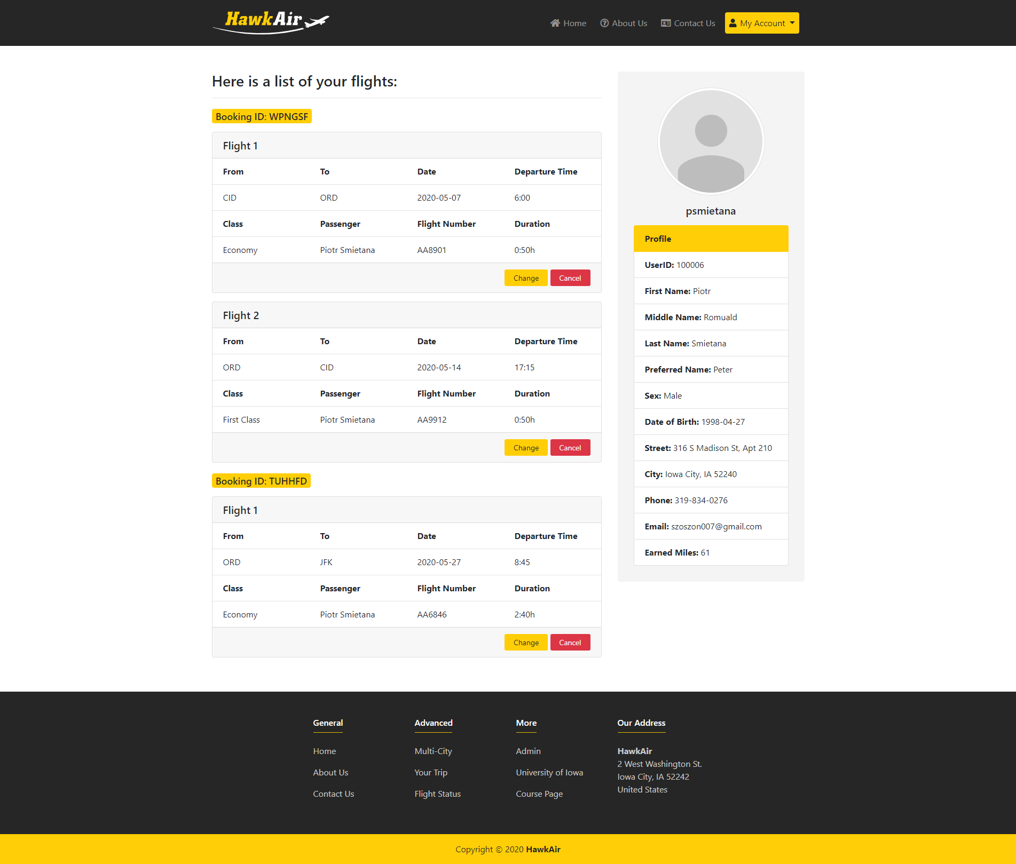
Technologies
MySQL
Python
Flask
Bootstrap
HTML / CSS
JavaScript

Slide 3
Process
We worked regularly throughout the semester.
We communicated using WhatsApp and we used GitHub to collaborate together.
Our biggest strength was teamwork. Everyone wanted to learn something and build a cool database system.
Thanks to great communication, working remotely was not a big challenge for us. We just had to move our weekly meetings to Zoom.
We were splitting the workload evenly among each other.

Slide 4
Features
One-way flights
Round trip flights
Multi-city flights
Your trips / Dashboard
Flight status
News
About us
Contact us
Login
Register
Admin panel
Payments
Multiple passengers
Mileage program
Email notifications
Customer support
Trip cancellation
Trip change
SHA-2 encryption
Forgot username
Forgot password
CRUD

Slide 5
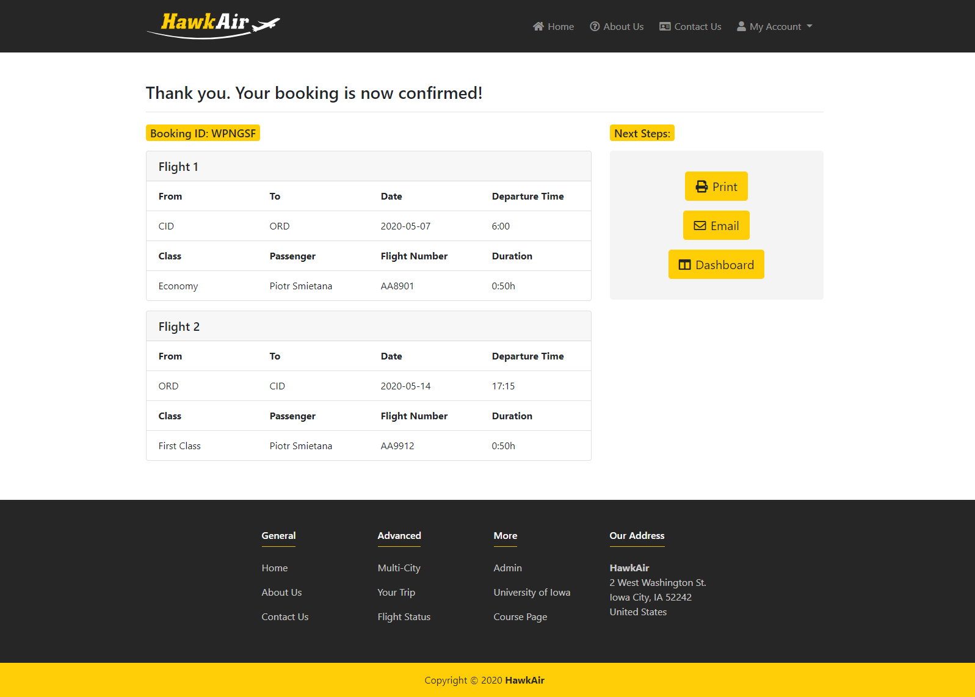
Summary
Simple
Easy to use
High performance
Data consistency
Secure (SHA-2, JWT)
Robust design
Data driven approach
Concurrency

